Slide 1

Acute Stroke Ready Hospital
Education & Training
BE FAST

Slide 2
What is a Stroke?
Stroke is a “Brain attack”
Occurs when blood vessels in the brain become
blocked or burst
2 million brain cells die every minute
Consequences of a stroke can be long-term disability or even death
Medical treatment exists that may reduce the effects of the stroke
Know the possible signs and symptoms of stroke

Slide 3
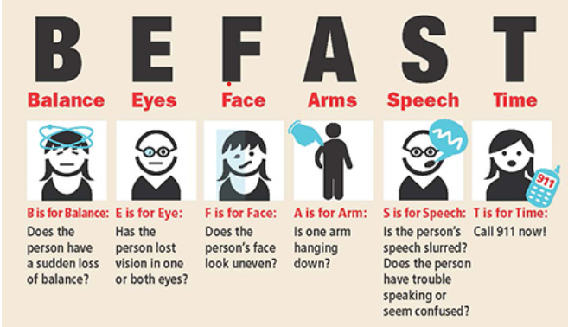
When it comes to Stroke BE FAST!
(this acronym can quickly help recognize signs of stroke)
https://www.joeniekrofoundation.com/stroke-2/b-e-f-a-s-t-save-a-life-from-stroke/

Slide 4
Balance
    Sudden loss of balance or coordination
    Trouble walking
    Wobbling around
    Dizziness
Eyes
Sudden blurred or double vision
Sudden loss of vision

Slide 5
Face
    Ask the person to smile - is one or both sides of the face drooping?
    Sudden – severe headache
    Numbness/tingling of the face
Arms
Ask the person to raise both arms – does one side drift downward?
Numbness/tingling/weakness on one side

Slide 6
Speech
    Slurred/garbled speech
    Can he/she repeat simple phrases?
    Unable to comprehend
Time
Note when symptoms began
Call Code Stroke immediately if you notice one or more of these signs

Slide 7
Code Stroke
Call console operator at “0” and have them page
Medical Alert+Stroke+Location+Directions (additional information) x4

